Slide 1
H35 (SN-OBS-1P) Daily Effective Snow-Covered Area Product Zuhal AKYUREK ^{1, 2} Semih KUTER ³ Kenan BOLAT ⁴
¹ Middle East Technical University (METU), Faculty of Engineering, Dept. of Civil Engineering, Ankara, Turkey
² METU, Graduate School of Natural and Applied Sciences, Dept. of Geodetic and Geographic Information Technologies, Ankara, Turkey
³ Çankırı Karatekin University, Faculty of Forestry, Dept. of Forest Engineering, Çankırı, Turkey
⁴ Hidrosaf Ltd., METU Technopolis, Ankara, Turkey
zakyurek@metu.edu.tr semihkuter@karatekin.edu.tr kenanbolat@hidrosaf.com

Slide 2
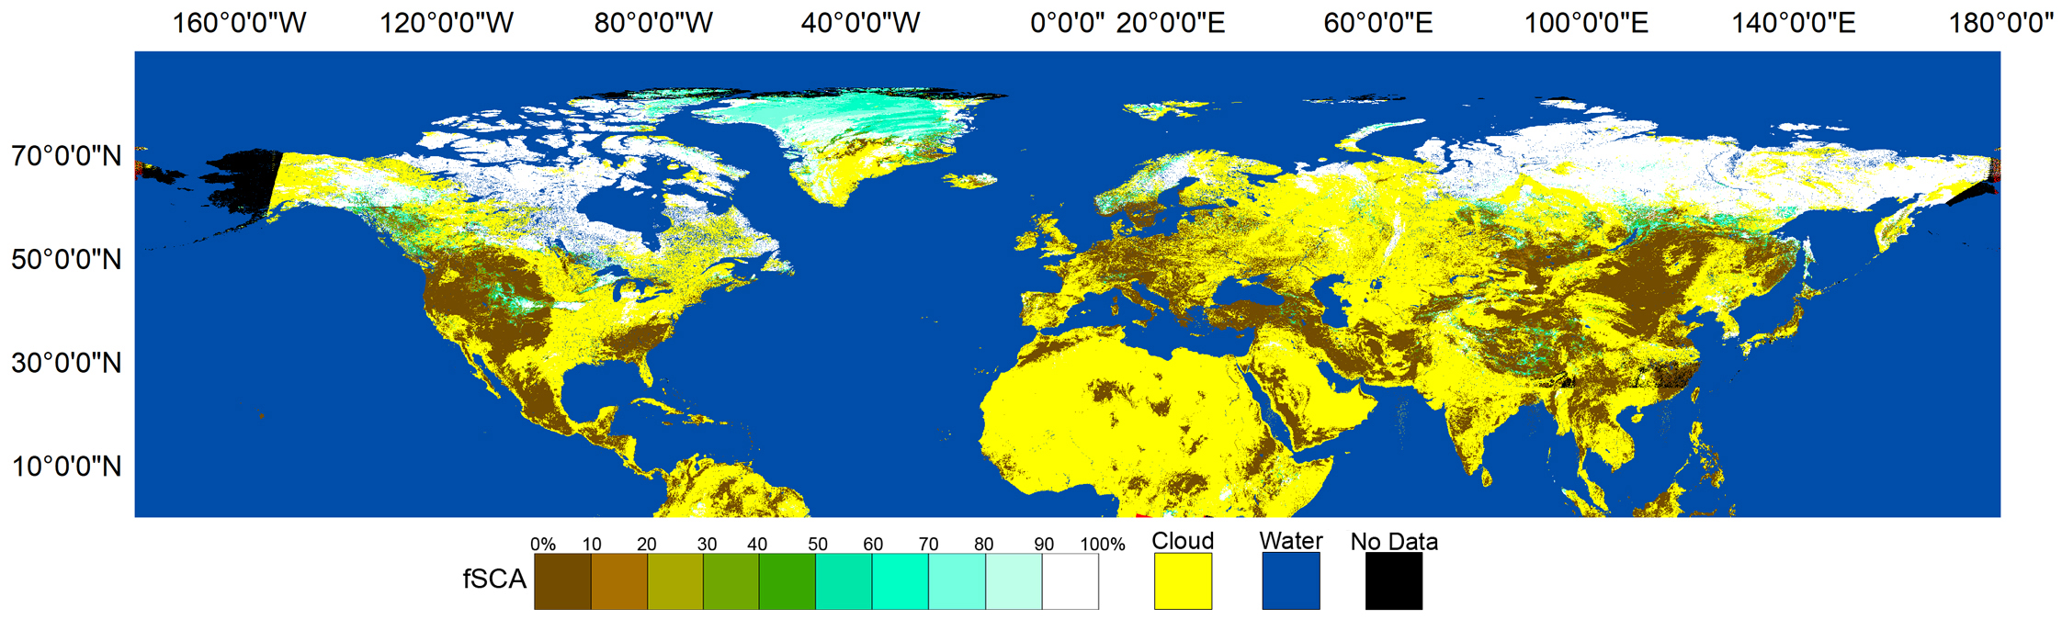
H35 (SN-OBS-1P) Daily Effective Snow-Covered Area Product
Pre-operational H35 (SN-OBS-1P) daily fractional snow-covered area (fSCA) product is developed within the frame of H-SAF (available as of March 2019).
Cycle: Daily
Coverage: Northern Hemisphere
Grid/Projection: EPSG 4326 (Lat/Lon Grid)
Resolution:
0.01 ° x 0.01 ° (~1 km )
Formats: gzip compressed GRIB2
Product digital coding:
[0, 100]: Ground - fSCA
101: Cloud
102: Sea/Water
104: Dark
105: No Data
H35 on 4 Apr 2020

Slide 3
H35 (SN-OBS-1P) Daily Effective Snow-Covered Area Product
H35 product is generated using the spectral data from the AVHRR sensor onboard to NOAA and MetOp satellites by traditional VIS/IR radiometry.
The product for the flat/forested regions: Finnish Meteorological Institute (FMI)
The product for the mountainous areas: Turkish State Meteorological Service (TSMS)
Both products, thereafter, are merged at FMI.
A full disk H35 product: An image of 8,999 rows by 35,999 columns (i.e., 324M pixels approximately)

Slide 4
H35 (SN-OBS-1P) Daily Effective Snow-Covered Area Product
Architecture of the H35 product generation chain
AVHRR/3 Spectral Bands (µm) | Band 1 : 0.580-0.680 Band 2 : 0.725-1.000 Band 3a : 1.580-1.640 Band 3b : 3.550-3.930 Band 4 : 10.300-11.300 Band 5 : 11.500-12.500

Slide 5
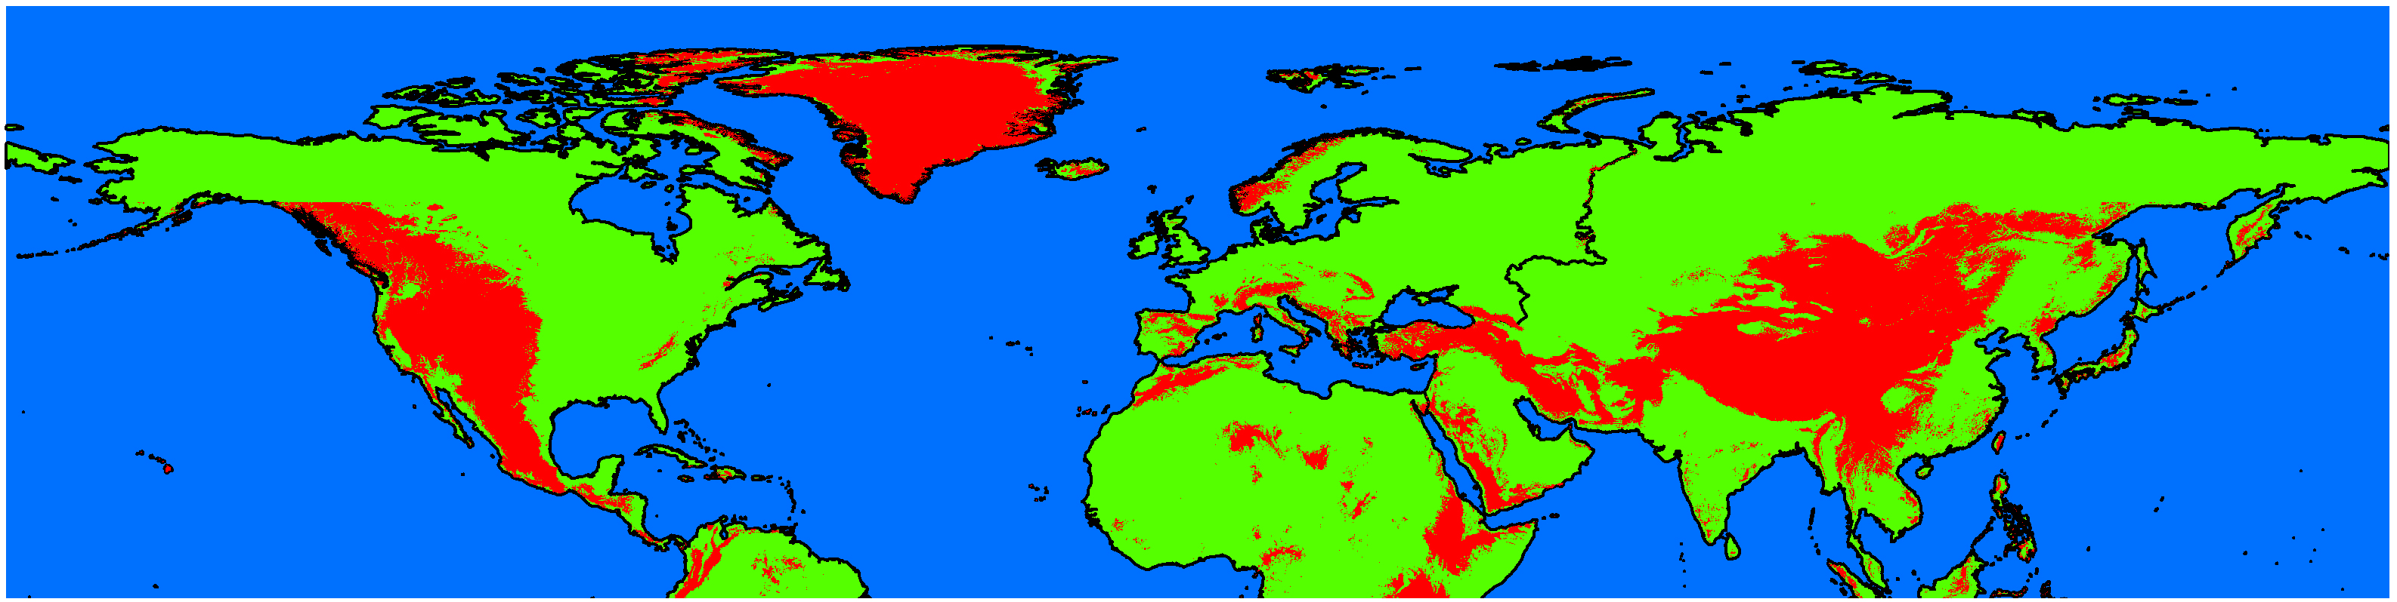
H35 (SN-OBS-1P) Daily Effective Snow-Covered Area Product
H35 Mask: Flat/Forested vs Mountainous Areas
Mountain
Flat/forested

Slide 6
H35 (SN-OBS-1P) Daily Effective Snow-Covered Area Product
For forested areas, it is essential to take accurate forest transmissivity into account.
Forest transmissivity map according to Metsämäki et al., 2005.
For mountainous areas, the sun zenith and azimuth angles, as well as direction of observation relative to these are more limiting factors.
Lambertian cosine correction (Vikhmar et al. 2004; Riano et al. 2003) for topographic effects.
Details are available here in the ATBD!

Slide 7
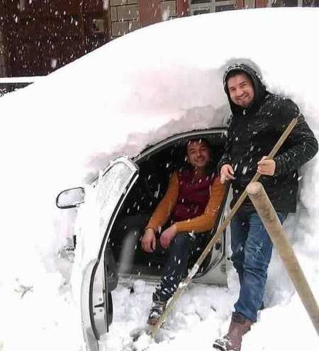
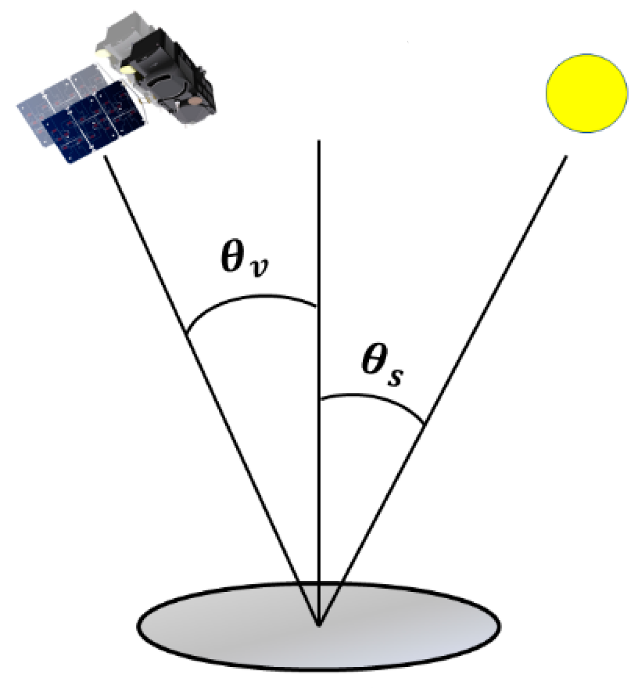

H35 (SN-OBS-1P) Daily Effective Snow-Covered Area Product
The most ideal scenario for the detection of snow cover with high accuracy
Clear sky
Good illumination and sensor viewing conditions
Snow cover with depth of several centimeters

Slide 8
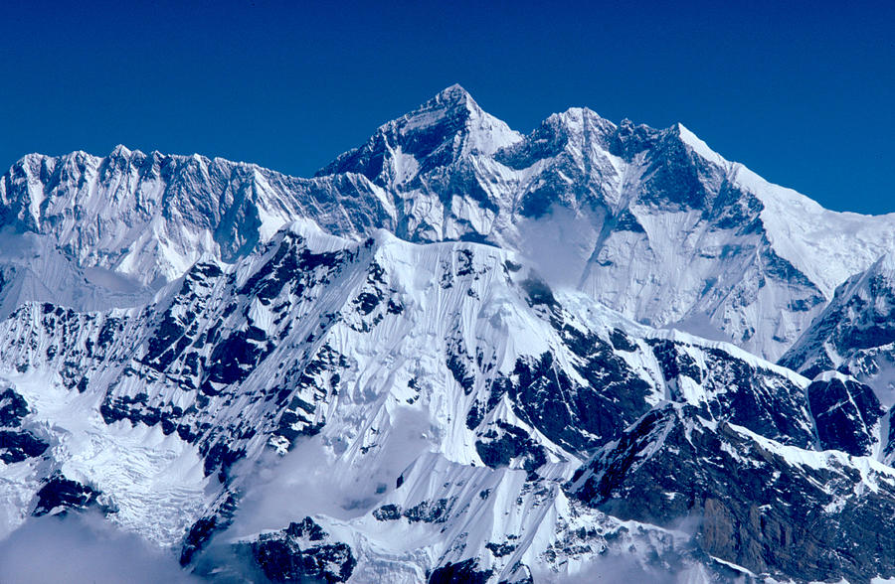
H35 (SN-OBS-1P) Daily Effective Snow-Covered Area Product
Known issues in snow cover retrieval by optical remote sensing at coarse resolution
Mixed-pixel problem over the areas with complex and rough topography

Slide 9
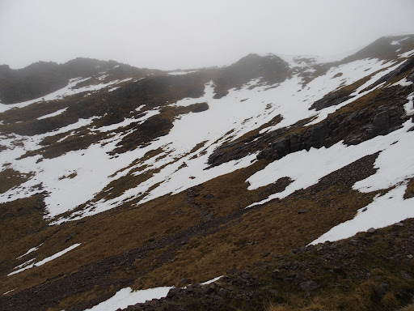
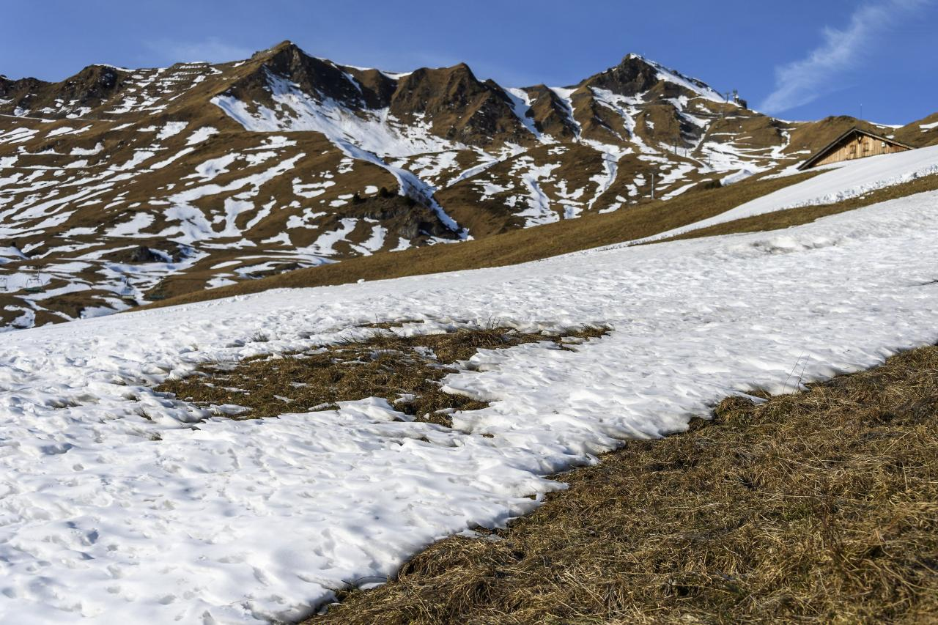
H35 (SN-OBS-1P) Daily Effective Snow-Covered Area Product
Known issues in snow cover retrieval by optical remote sensing at coarse resolution
Patchy snow cover due to melting

Slide 10
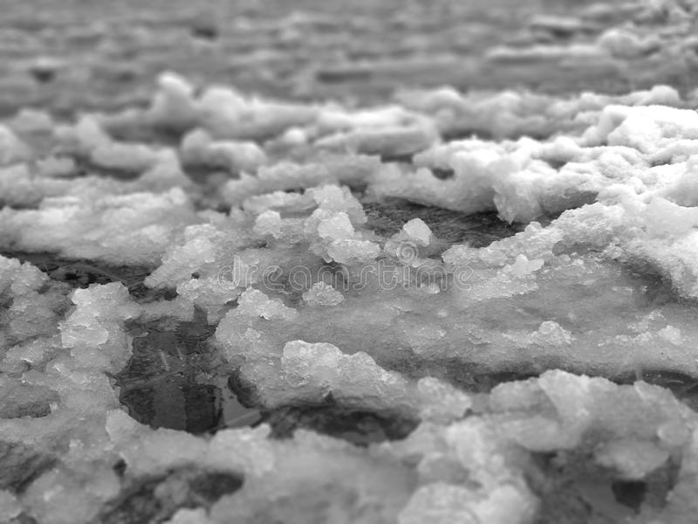
H35 (SN-OBS-1P) Daily Effective Snow-Covered Area Product
Known issues in snow cover retrieval by optical remote sensing at coarse resolution
Wet and shallow snow cover
High FAR and low POD values across the snow/land boundaries at the fringes of the slopes
 |  | Reference Data
 |  | Snow | No Snow
Satellite Product | Snow | HITS (A) | FALSE ALARMS (B) | HITS + FALSE ALARMS
 | No Snow | MISSES (C) | CORRECT NEGATIVES (D) | MISSES+ CORRECT NEGATIVES
 |  | HITS + MISSES | FALSE ALARMS + CORRECT NEGATIVES
Probability of detection (POD): A/(A+C)
False alarm ratio (FAR): B/(A+B)
Overall Accuracy (ACC): (A+D)/(A+B+C+D)

Slide 11
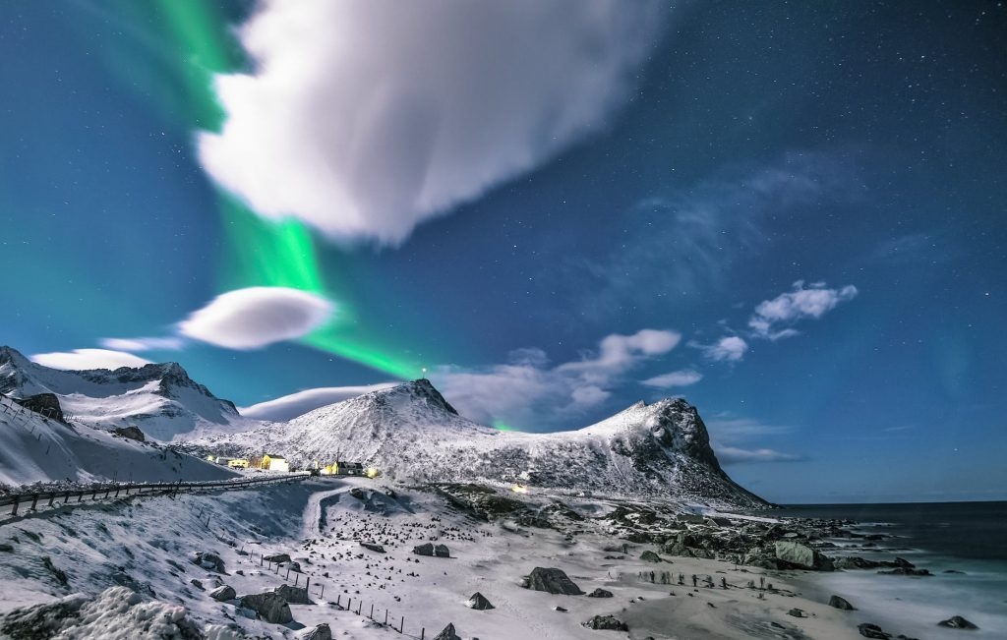
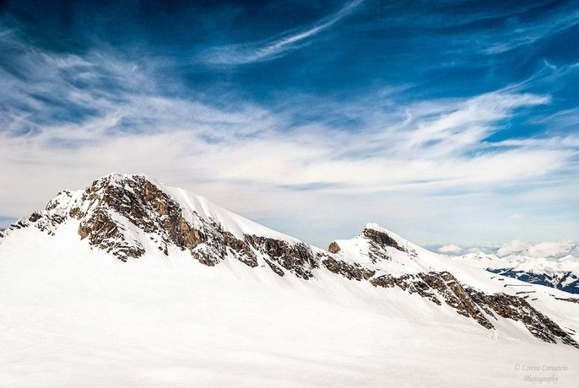
H35 (SN-OBS-1P) Daily Effective Snow-Covered Area Product
Known issues in snow cover retrieval by optical remote sensing at coarse resolution
Cloud/Snow confusion

Slide 12
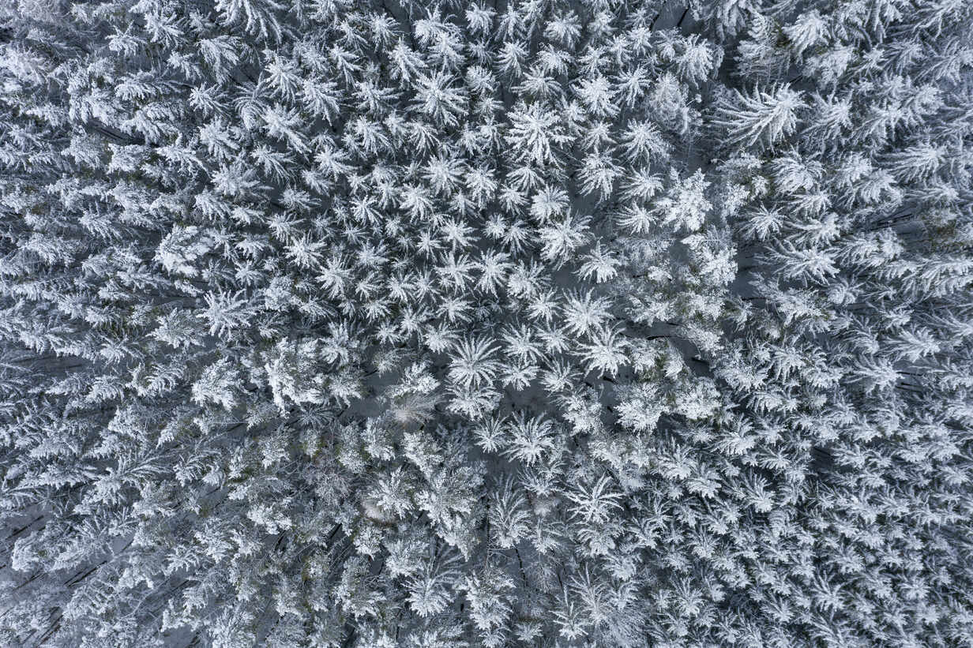
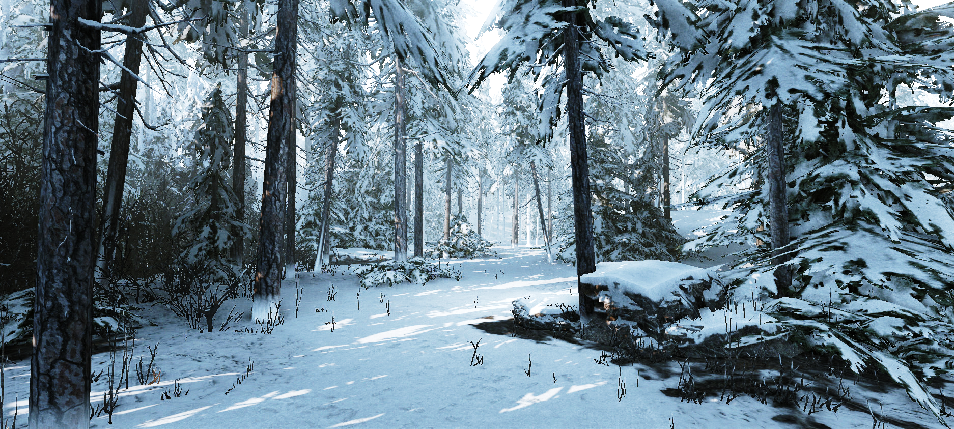
H35 (SN-OBS-1P) Daily Effective Snow-Covered Area Product
Known issues in snow cover retrieval by optical remote sensing at coarse resolution
Snow cover under dense forest canopy

Slide 13
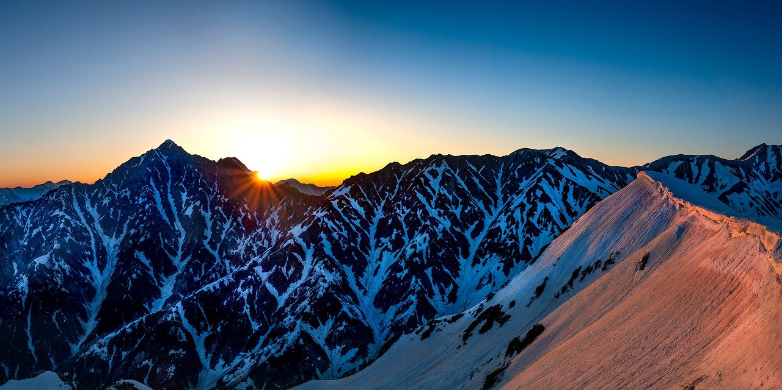
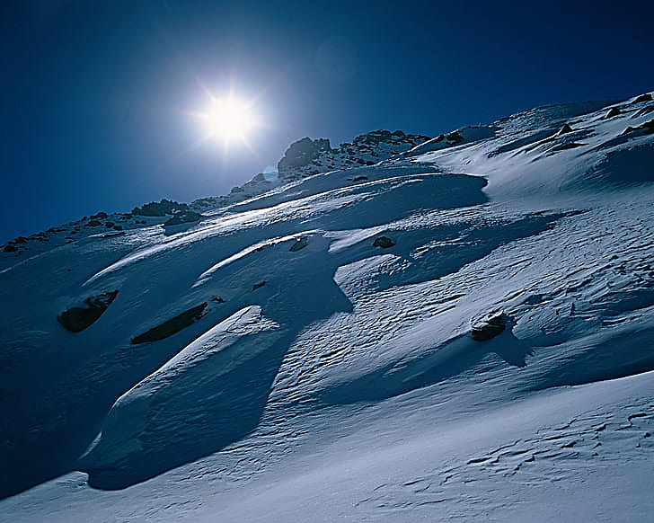
H35 (SN-OBS-1P) Daily Effective Snow-Covered Area Product
Known issues in snow cover retrieval by optical remote sensing at coarse resolution
Variations in illumination conditions over rough mountainous terrains

Slide 14
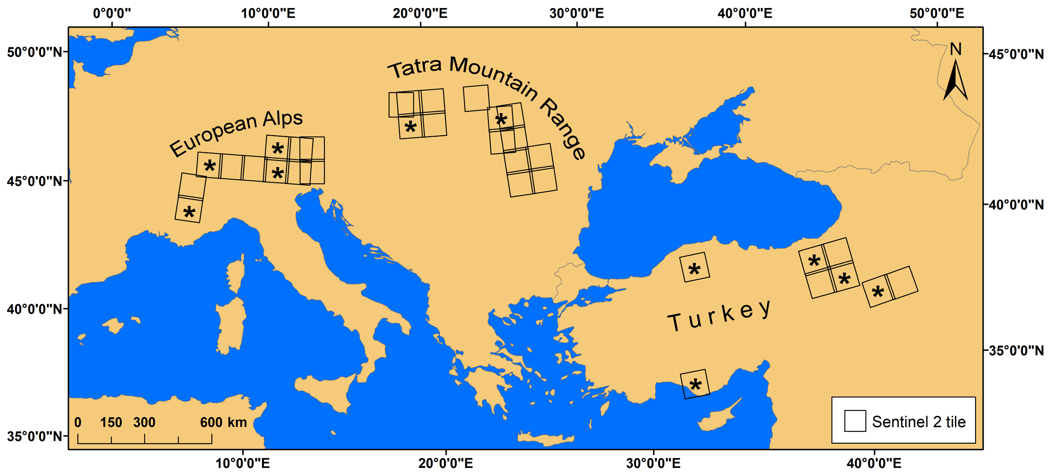
H35 (SN-OBS-1P) Daily Effective Snow-Covered Area Product
Improving the accuracy of H35 over mountainous terrains by Machine Learning
Multivariate Adaptive Regression Splines (MARS) (Friedman, 1991)
Reference data for training from higher resolution Sentinel 2 imagery

Slide 15
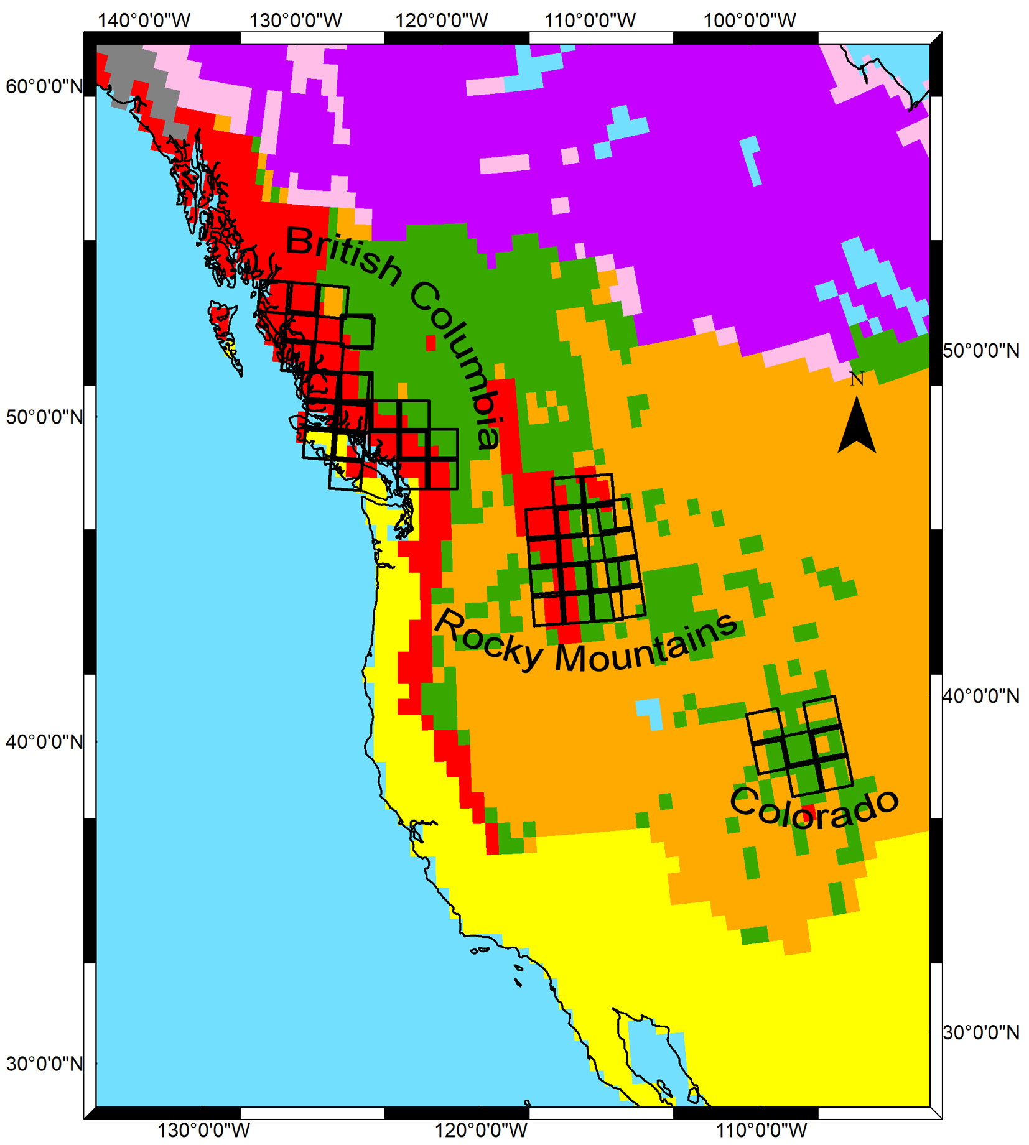
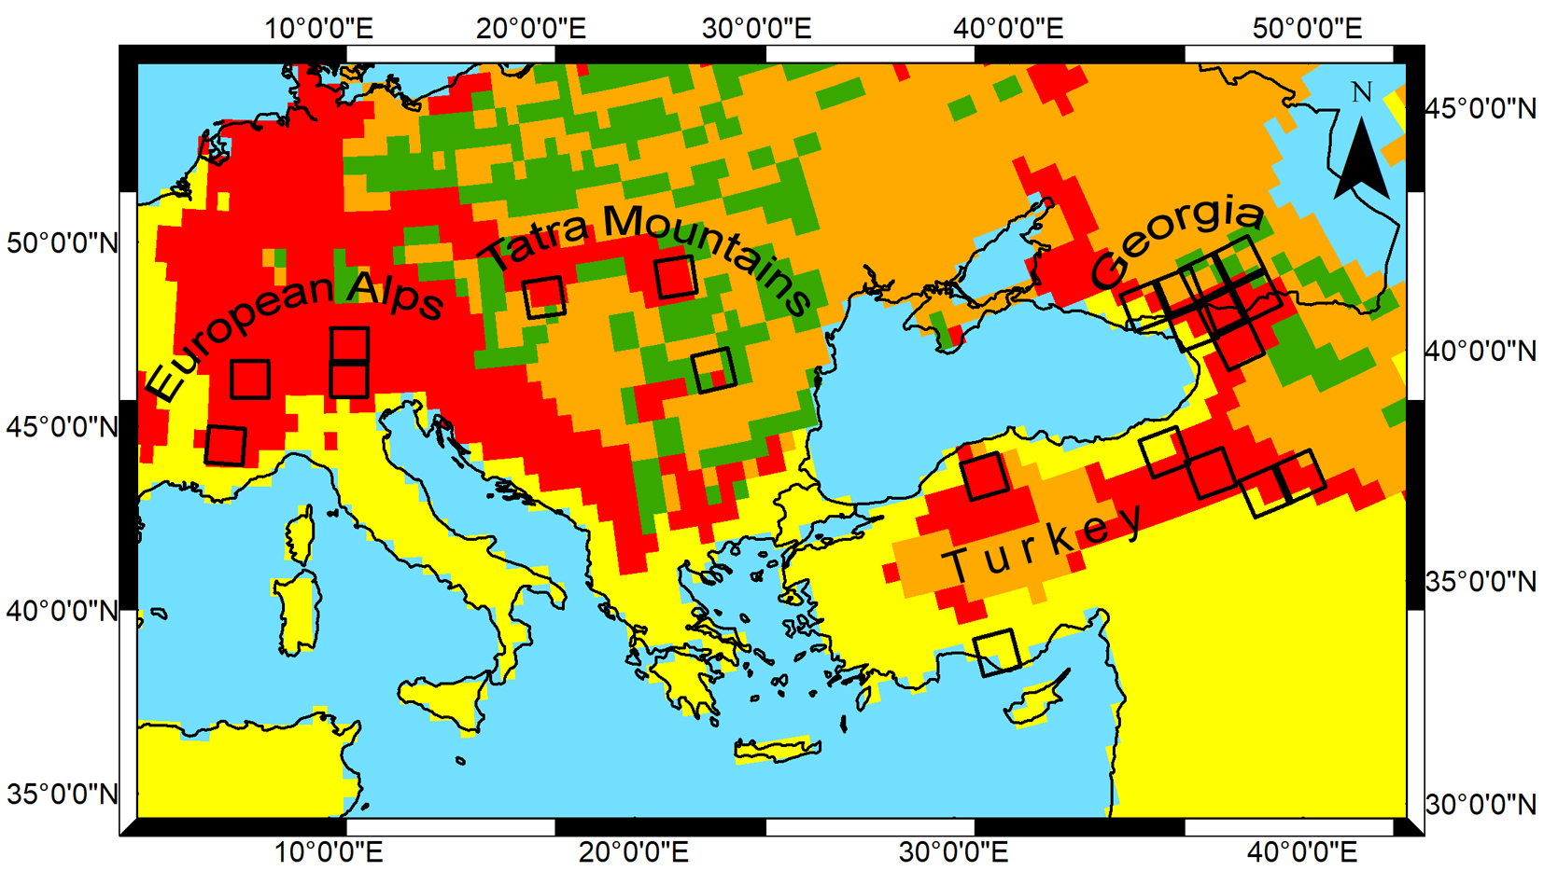
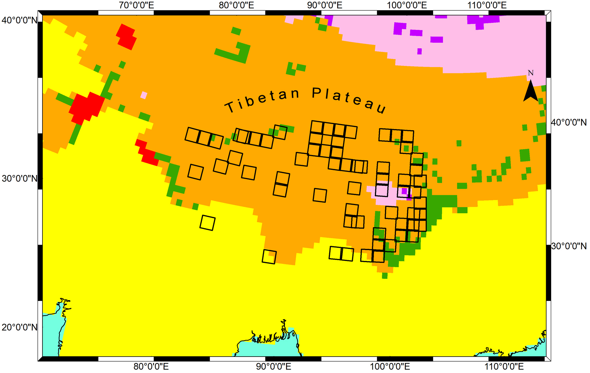
H35 (SN-OBS-1P) Daily Effective Snow-Covered Area Product
Improving the accuracy of H35 over mountainous terrains by Machine Learning
Testing with reference fSCA maps: Sentinel 2 imagery wrt Sturm’s (1995) snow cover types
450 Sentinel 2 images

Slide 16
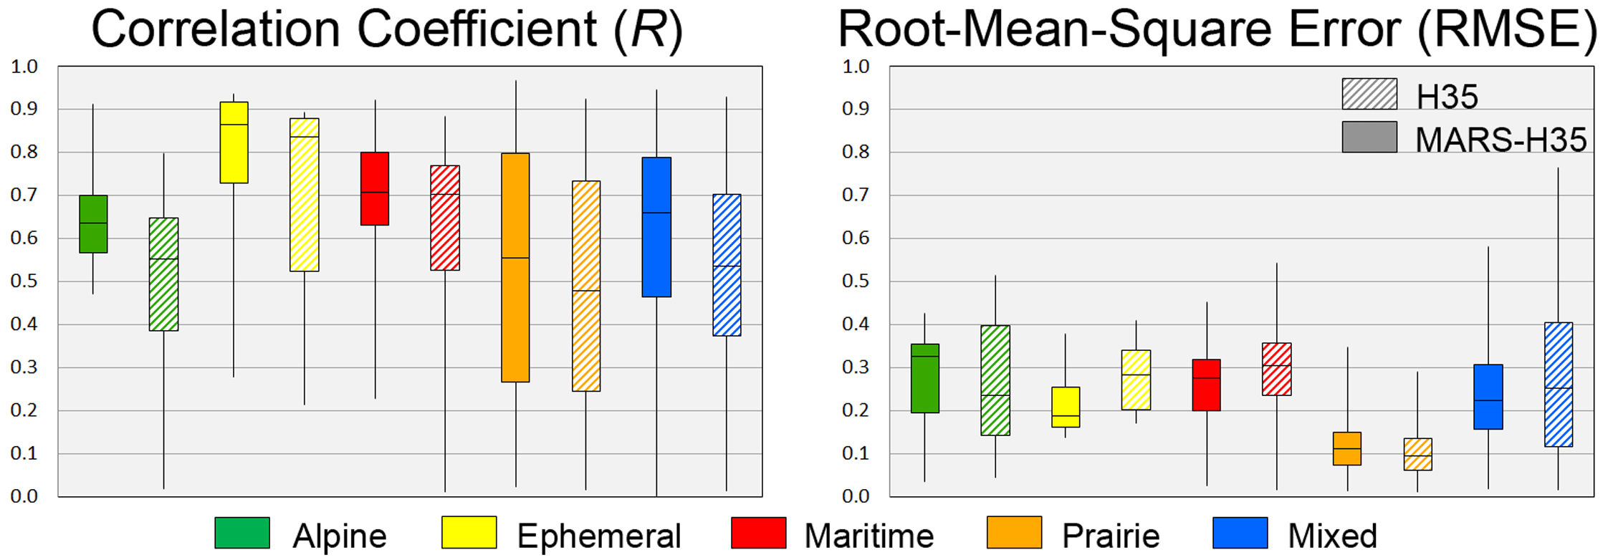
H35 (SN-OBS-1P) Daily Effective Snow-Covered Area Product
Improving the accuracy of H35 over mountainous terrains by Machine Learning
Testing with reference fSCA maps: Sentinel 2 imagery wrt Sturm’s (1995) snow cover types

Slide 17
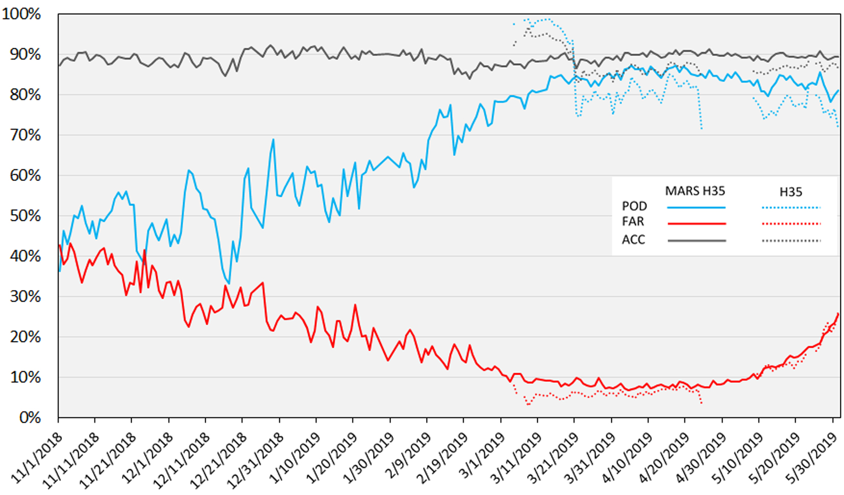
H35 (SN-OBS-1P) Daily Effective Snow-Covered Area Product
Improving the accuracy of H35 over mountainous terrains by Machine Learning
Testing with ERA5-Land snow depth data (Northern Hemisphere)

Slide 18
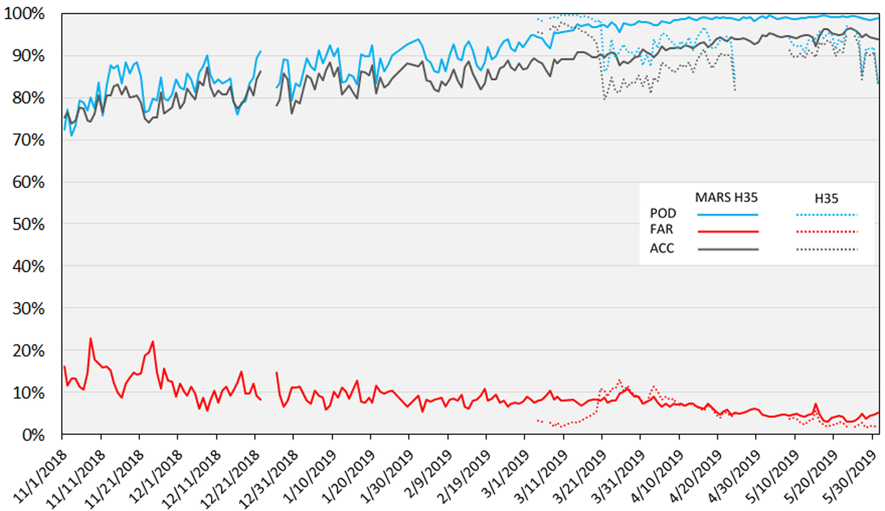
H35 (SN-OBS-1P) Daily Effective Snow-Covered Area Product
Improving the accuracy of H35 over mountainous terrains by Machine Learning
Testing with MODIS MOD10A1 C6 NDSI data (Northern Hemisphere)

Slide 19
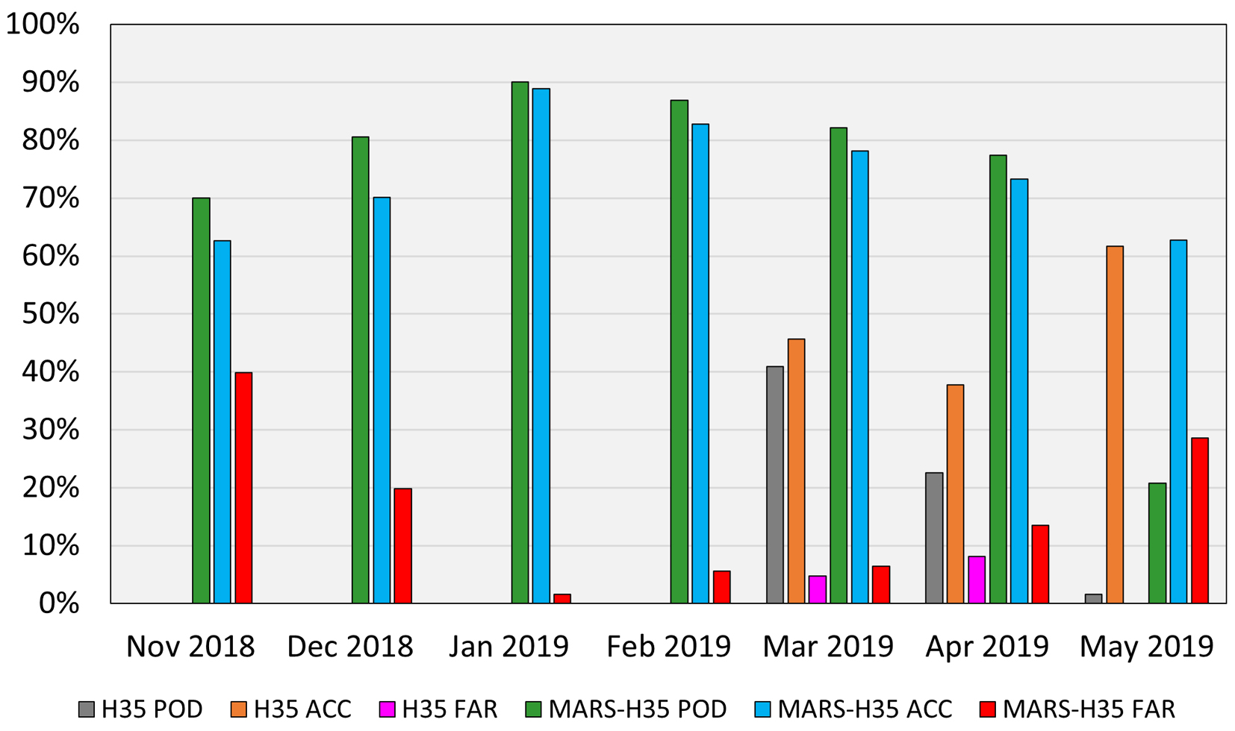
H35 (SN-OBS-1P) Daily Effective Snow-Covered Area Product
Improving the accuracy of H35 over mountainous terrains by Machine Learning
Testing with in-situ snow depth data (Turkey)
MARS-H35 overperforms

Slide 20
H35 (SN-OBS-1P) Daily Effective Snow-Covered Area Product
H86: Effective Snow Cover by EPS-SG METimage
Successor of H35: Improved version by implementing Machine Learning (MARS)
Algorithm development and refinement is still in progress
Cycle: Daily
Coverage: Northern Hemisphere
Grid/Projection: Equidistant cylindrical
Resolution: 0.01º x 0.01º
Formats: HDF5, PNG quicklook
Operational status: In development

Slide 21
H35 (SN-OBS-1P) Daily Effective Snow-Covered Area Product
References
Friedman, J. H. (1991). Multivariate adaptive regression splines. The Annals of Statistics, 19, 1-67.
Metsämäki, S. J., Anttila, S. T., Markus, H. J. and Vepsäläinen, J. M. (2005). A feasible method for fractional snow cover mapping in boreal zone based on a reflectance model. Remote Sensing of Environment, 95, 77-95.
Portenier, C., Hüsler, F., Härer, S. and Wunderle, S. (2020). Towards a webcam-based snow cover monitoring network: methodology and evaluation. The Cryosphere, 14, 1409-1423.
Riano D., E. Chuvieco, J. Salas and I. Aguado. (2003). Assessment of different topographic corrections in landsat-tm data for mapping vegetation types. IEEE Trans. Geosci. Remote Sensing, 41, 1056-1061.
Sturm, M., Holmgren, J. and Liston, G. E. (1995). A Seasonal Snow Cover Classification System for Local to Global Applications. Journal of Climate, 8, 1261-1283.
Vikhamar D., R. Solberg and K. Seidel. (2004). Reflectance Modeling of Snow-covered forests in hilly terrain. Photogrametric Engineering and Remote Sensing, 70, 9, 1069-1079.

Slide 22
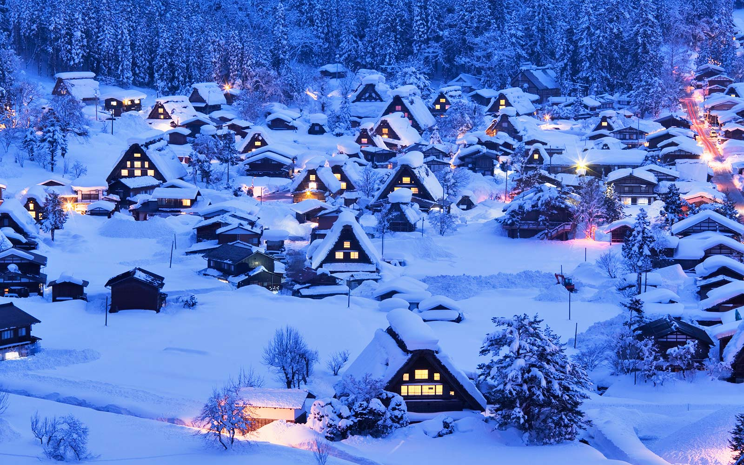
H35 (SN-OBS-1P) Daily Effective Snow-Covered Area Product
Thank You...

